Slide 1
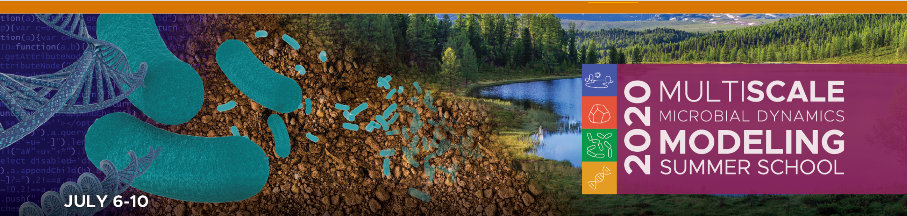
Connecting Metabolites to Function Substrate-explicit Modeling of Environmental Microbial Community Dynamics
Substrates
(E_{d}, E_{a})
Products
Catabolism
ΔG_{Cat}
Metabolic
reaction
ΔG_{Dis}
ΔG_{An}
Anabolism
C-source N-source
Biom
Hyun-Seob Song
University of Nebraska-Lincoln

Slide 2


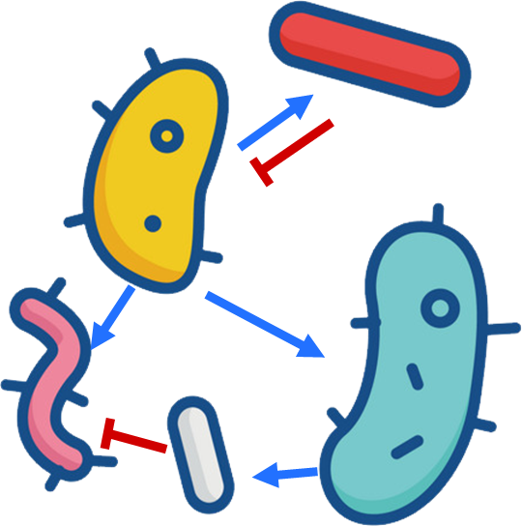


Key components in microbial processes: microbes, enzymes, and substrates
Complex
organic
matters
Simple organic compounds
Biogeo-
chemical
model
Substrates
Microbes
Enzymes
Inorganic
minerals
Predictive biogeochemical need to properly account for their dynamic interplay

Slide 3
Microbe-substrate-enzyme interactions have been considered at a lumped level in earlier models
Modeling structure in earlier approaches
Data measurement technologies
Interpretation
Metagenomics
Transcriptomics
Proteomics
Metabolomics
Stable Isotope Labeling (SIP)
?
Parameterization
Predictions limited to lumped variables
Unable to make precise prediction of control points
Huge gaps with modern molecular data
Unable to interpret omics data as molecular signatures
Not effectively parameterizable from omics data

Slide 4

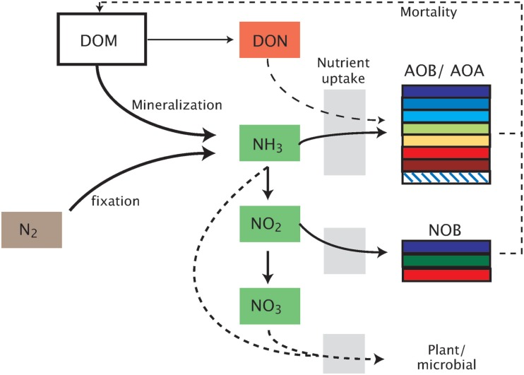
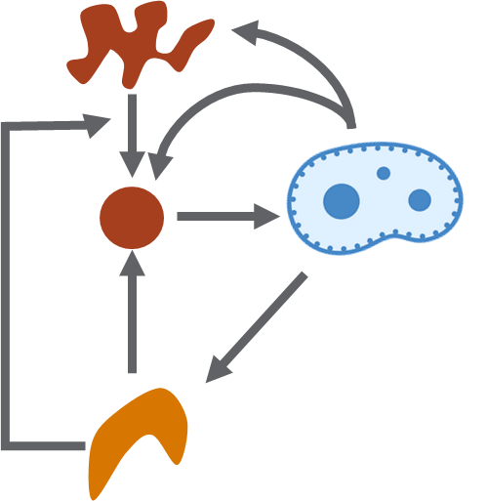
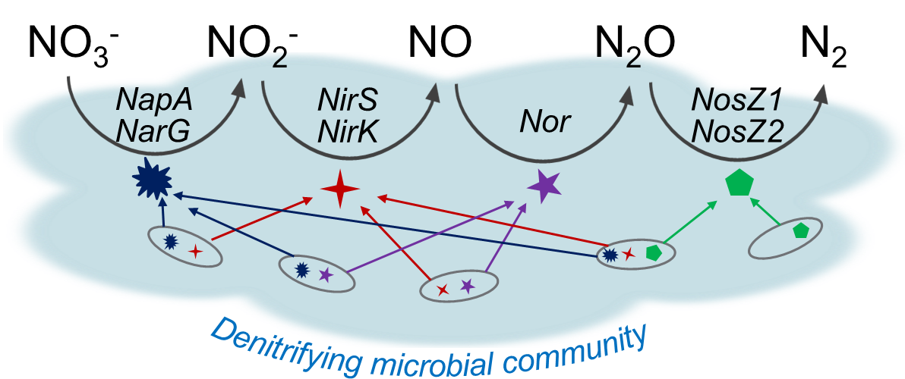
Structured modeling of microbial and enzyme dynamics
Microbially-explicit modeling
SORPSE
MIMICS
MEND
RESOM
DEMEND
16s rRNA
Metagenomics
MAGs
Bouskill et al.
(2012)
Enzyme-explicit modeling
Metatranscriptomics
Metaproteomics
Song et al. (2017)

Slide 5
Another critical component for integrative modeling is missing
?
Oversimplification of substrate transformation impedes further elaboration of microbial- and enzyme-explicit modeling (therefore, a bottleneck towards high-fidelity biogeochemical modeling)
Metabolomics:
Actual functional status of microbial communities
Superglue of omics (Geira et al., 2018)
New insights into microbe-DOM interactions (and the impact of microbes on the global carbon cycle)
Substrate-explicit modeling
Integration of metabolomics

Slide 6
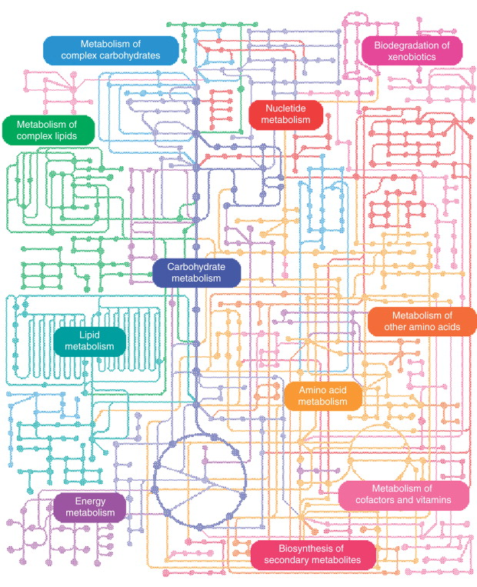

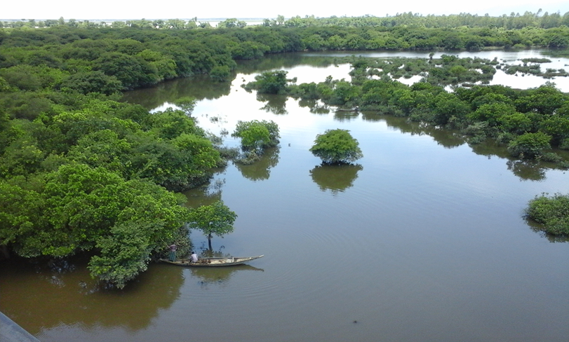
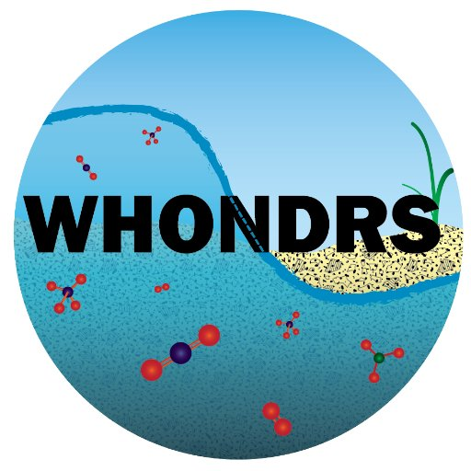
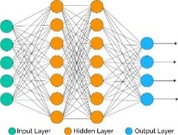

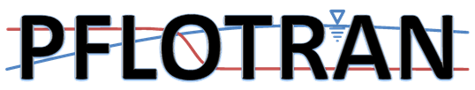
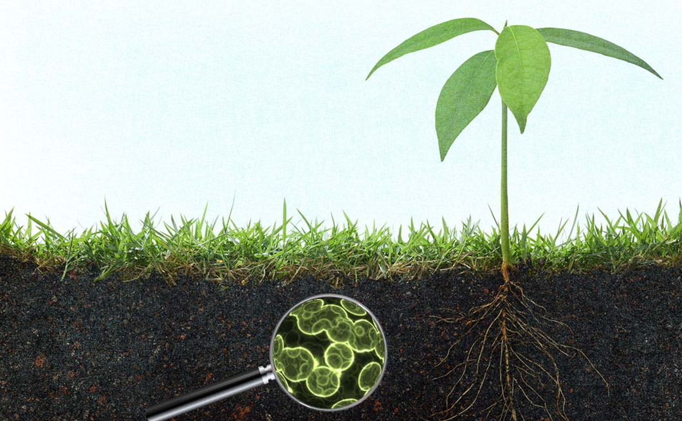
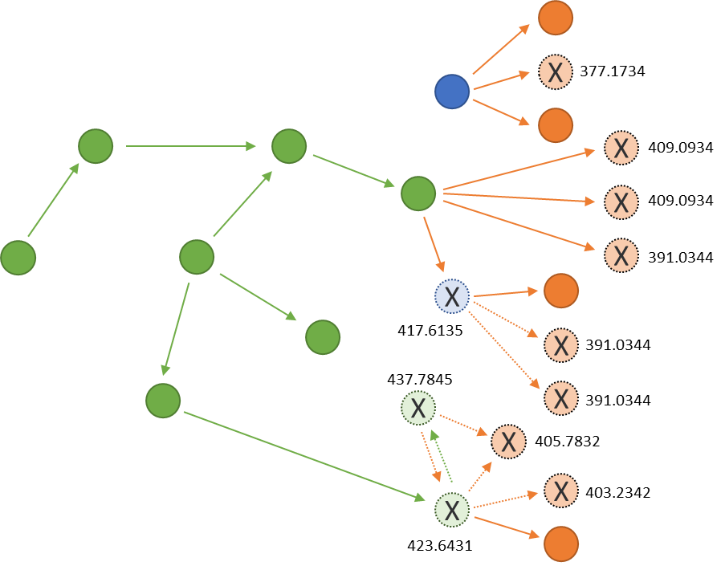
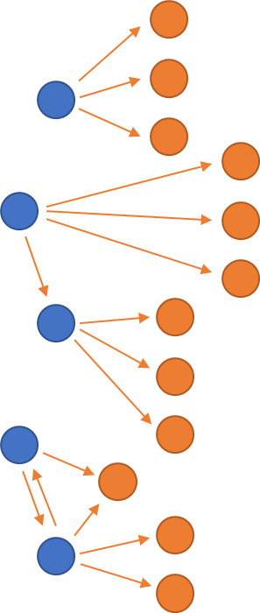
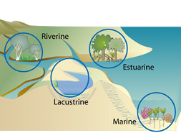
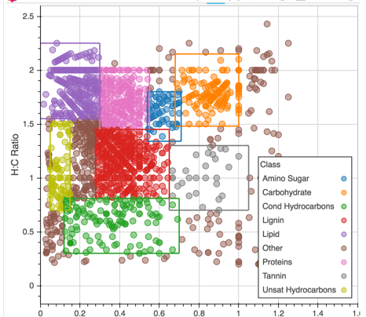
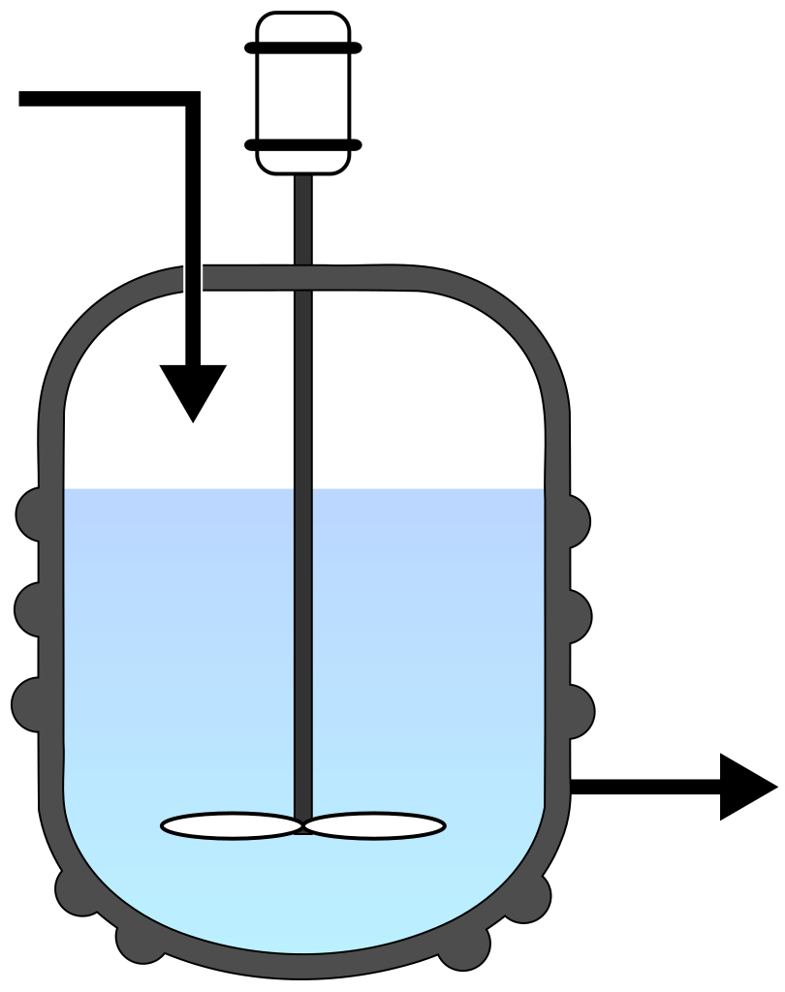
Trait-based BGC model
Individual taxa
Metagenome-assembled genomes (MAGs)
DRAM
BGC function
Reduced-order BGC model
DRAM
Binning
Metagenomes
Entire community
FTICR-MS
Reactive-transport model for 1-D column
Formularity
Chemical formulas
Expanded network
Metabolite-derived network
Cybernetic model
ftmsRanalysis
& FREDA
Large-scale applications
Thermodynamics
Cybernetic model
Reaction kinetics
0-D batch and CSTR

Slide 7
Thermodynamic theories for converting chemical formulae to stoichiometries and reaction rates
Energy coupling between catabolic and anabolic reactions
Transition theory for microbial division
S(E_{d}, E_{a})
P
Catabolism
ΔG_{Cat}
ΔG_{Dis}
Metabolic
reaction
ΔG_{An}
Dissipation
Anabolism
OC, Ns
Biom
Quemener and Bouchez (2014)

Slide 8

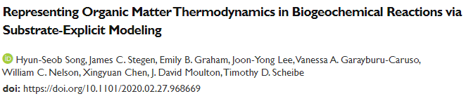

Slide 9
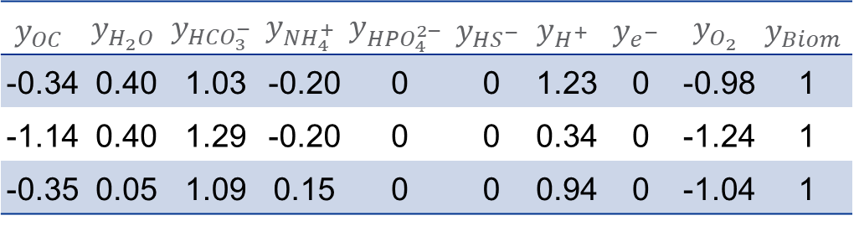

From elemental compositions (a,b,…,z) to reaction stoichiometries ($y_{S_{i}}$)
OC | Formula | C | H | O | N | S | P | Z
Glucose | C₆H₁₂O₆ | 6 | 12 | 6 | 0 | 0 | 0 | 0
Acetate | C₂H₃O₂⁻ | 2 | 3 | 2 | 0 | 0 | 0 | -1
Glucosamine | C₆H₁₃NO₅ | 6 | 13 | 5 | 1 | 0 | 0 | 0
$$y_{OC}$$ | $$y_{H_{2}O}$$ | $$y_{{HCO}_{3}^{−}}$$ | $$y_{{NH}_{4}^{+}}$$ | $$y_{{HPO}_{4}^{2−}}$$ | $$y_{{HS}^{−}}$$ | $$y_{H^{+}}$$ | $$y_{e^{−}}$$ | $$y_{O_{2}}$$ | $$y_{Biom}$$
-0.34 | 0.40 | 1.03 | -0.20 | 0 | 0 | 1.23 | 0 | -0.98 | 1
-1.14 | 0.40 | 1.29 | -0.20 | 0 | 0 | 0.34 | 0 | -1.24 | 1
-0.35 | 0.05 | 1.09 | 0.15 | 0 | 0 | 0.94 | 0 | -1.04 | 1

Slide 10
Metabolism: an energetically coupled network of catabolism and anabolism
Substrates
(E_{d}, E_{a})
Substrates
(E_{d}, E_{a})
Products
Products
Catabolism
Catabolism
ΔG_{Cat}
Metabolic
reaction
ATP_{Cat}
ΔG_{Dis}
ΔG_{An}
m_{ATP}
ATP_{An}
Anabolism
Anabolism
C-source N-source
Biom
C-source N-source
Biom
The parameter λ implies how many times the catabolic reaction needs to run in order to provide the energy required for the synthesis of one C-mole of biomass and thus is a measure of thermodynamic inefficiency of OC

Slide 11
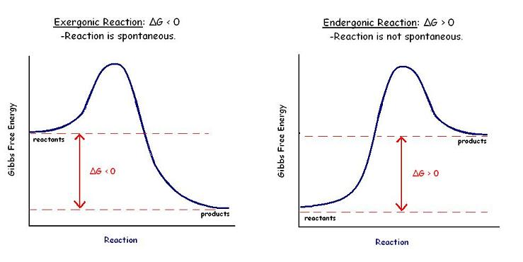
Reaction is spontaneous if ΔG < 0
The second law of thermodynamics:
Chemists identified a way to determine spontaneity by using the Gibbs free energy
At constant T and P,
Thermodynamically favorable
Thermodynamically unfavorable
-
+
0
https://step1.medbullets.com/pharmacology/107001/enzyme-kinetics

Slide 12
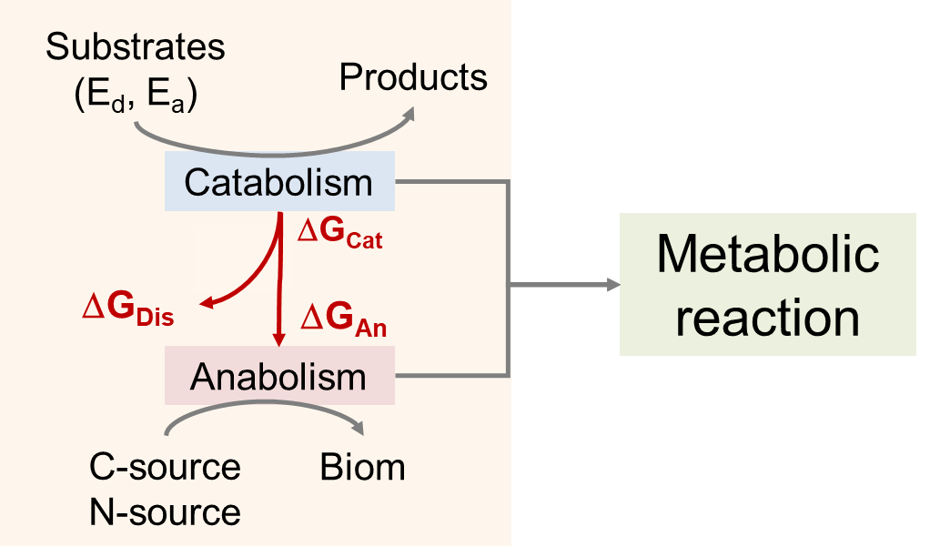
Catabolic reaction

Slide 13
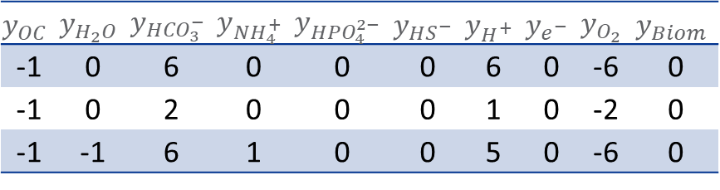
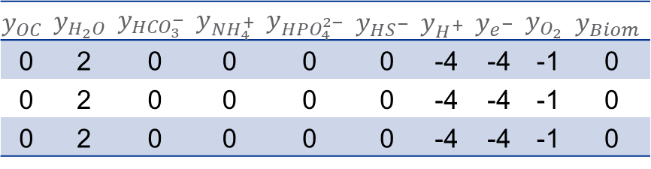
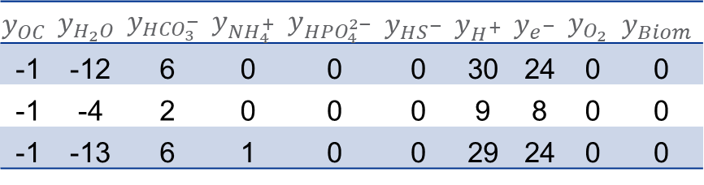
Catabolic reaction: combining two half reactions
OC | Formula | C | H | O | N | S | P | Z
Glucose | C₆H₁₂O₆ | 6 | 12 | 6 | 0 | 0 | 0 | 0
Acetate | C₂H₃O₂⁻ | 2 | 3 | 2 | 0 | 0 | 0 | -1
Glucosamine | C₆H₁₃NO₅ | 6 | 13 | 5 | 1 | 0 | 0 | 0
$$y_{OC}$$ | $$y_{H_{2}O}$$ | $$y_{{HCO}_{3}^{−}}$$ | $$y_{{NH}_{4}^{+}}$$ | $$y_{{HPO}_{4}^{2−}}$$ | $$y_{{HS}^{−}}$$ | $$y_{H^{+}}$$ | $$y_{e^{−}}$$ | $$y_{O_{2}}$$ | $$y_{Biom}$$
-1 | -12 | 6 | 0 | 0 | 0 | 30 | 24 | 0 | 0
-1 | -4 | 2 | 0 | 0 | 0 | 9 | 8 | 0 | 0
-1 | -13 | 6 | 1 | 0 | 0 | 29 | 24 | 0 | 0
$$y_{OC}$$ | $$y_{H_{2}O}$$ | $$y_{{HCO}_{3}^{−}}$$ | $$y_{{NH}_{4}^{+}}$$ | $$y_{{HPO}_{4}^{2−}}$$ | $$y_{{HS}^{−}}$$ | $$y_{H^{+}}$$ | $$y_{e^{−}}$$ | $$y_{O_{2}}$$ | $$y_{Biom}$$
-1 | 0 | 6 | 0 | 0 | 0 | 6 | 0 | -6 | 0
-1 | 0 | 2 | 0 | 0 | 0 | 1 | 0 | -2 | 0
-1 | -1 | 6 | 1 | 0 | 0 | 5 | 0 | -6 | 0
$$y_{OC}$$ | $$y_{H_{2}O}$$ | $$y_{{HCO}_{3}^{−}}$$ | $$y_{{NH}_{4}^{+}}$$ | $$y_{{HPO}_{4}^{2−}}$$ | $$y_{{HS}^{−}}$$ | $$y_{H^{+}}$$ | $$y_{e^{−}}$$ | $$y_{O_{2}}$$ | $$y_{Biom}$$
0 | 2 | 0 | 0 | 0 | 0 | -4 | -4 | -1 | 0
0 | 2 | 0 | 0 | 0 | 0 | -4 | -4 | -1 | 0
0 | 2 | 0 | 0 | 0 | 0 | -4 | -4 | -1 | 0

Slide 14
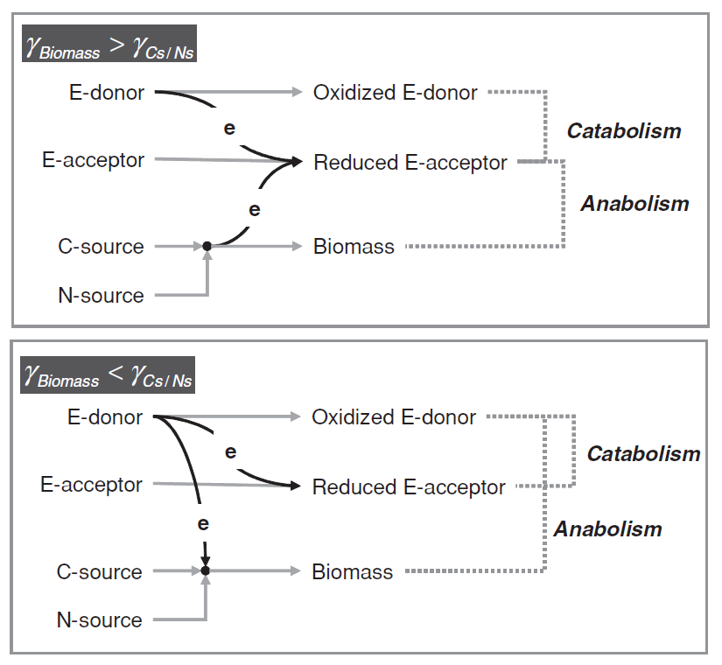
Anabolic reaction and electron flows
Kleerebezem and Van Loosdrecht (2010)

Slide 15
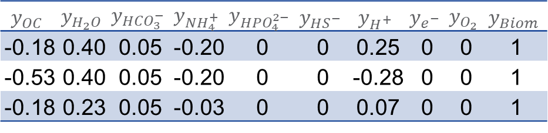
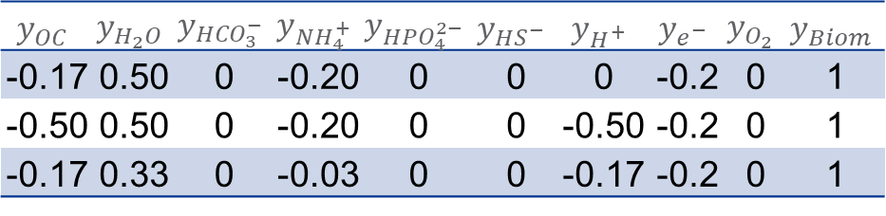
Anabolic reaction
$$y_{OC}$$ | $$y_{H_{2}O}$$ | $$y_{{HCO}_{3}^{−}}$$ | $$y_{{NH}_{4}^{+}}$$ | $$y_{{HPO}_{4}^{2−}}$$ | $$y_{{HS}^{−}}$$ | $$y_{H^{+}}$$ | $$y_{e^{−}}$$ | $$y_{O_{2}}$$ | $$y_{Biom}$$
-0.17 | 0.50 | 0 | -0.20 | 0 | 0 | 0 | -0.2 | 0 | 1
-0.50 | 0.50 | 0 | -0.20 | 0 | 0 | -0.50 | -0.2 | 0 | 1
-0.17 | 0.33 | 0 | -0.03 | 0 | 0 | -0.17 | -0.2 | 0 | 1
OC | Formula | C | H | O | N | S | P | Z
Glucose | C₆H₁₂O₆ | 6 | 12 | 6 | 0 | 0 | 0 | 0
Acetate | C₂H₃O₂⁻ | 2 | 3 | 2 | 0 | 0 | 0 | -1
Glucosamine | C₆H₁₃NO₅ | 6 | 13 | 5 | 1 | 0 | 0 | 0
$$y_{OC}$$ | $$y_{H_{2}O}$$ | $$y_{{HCO}_{3}^{−}}$$ | $$y_{{NH}_{4}^{+}}$$ | $$y_{{HPO}_{4}^{2−}}$$ | $$y_{{HS}^{−}}$$ | $$y_{H^{+}}$$ | $$y_{e^{−}}$$ | $$y_{O_{2}}$$ | $$y_{Biom}$$
-0.18 | 0.40 | 0.05 | -0.20 | 0 | 0 | 0.25 | 0 | 0 | 1
-0.53 | 0.40 | 0.05 | -0.20 | 0 | 0 | -0.28 | 0 | 0 | 1
-0.18 | 0.23 | 0.05 | -0.03 | 0 | 0 | 0.07 | 0 | 0 | 1

Slide 16
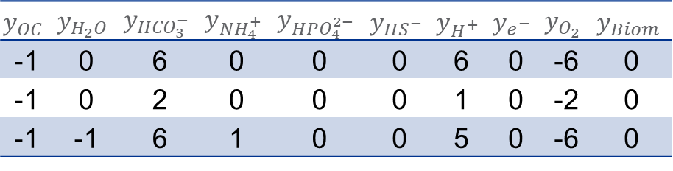
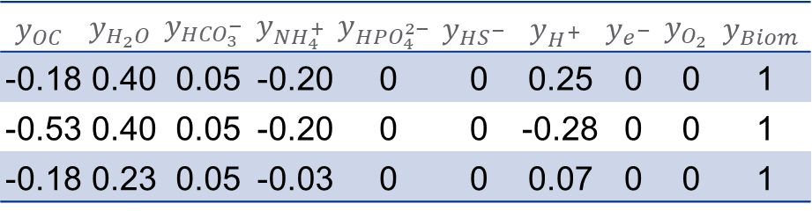
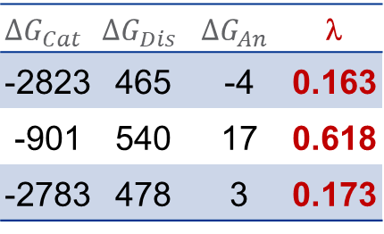
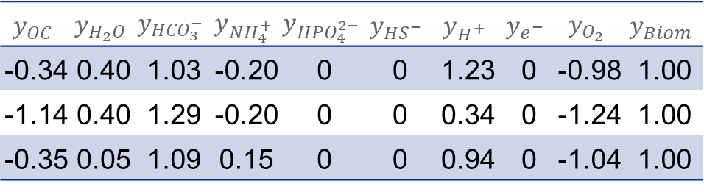
Metabolic reactions by combining catabolic and anabolic reactions
OC | Formula | C | H | O | N | S | P | Z
Glucose | C₆H₁₂O₆ | 6 | 12 | 6 | 0 | 0 | 0 | 0
Acetate | C₂H₃O₂⁻ | 2 | 3 | 2 | 0 | 0 | 0 | -1
Glucosamine | C₆H₁₃NO₅ | 6 | 13 | 5 | 1 | 0 | 0 | 0
[kJ/mol]
$${ΔG}_{Cat}$$ | $${ΔG}_{Dis}$$ | $${ΔG}_{An}$$ | λ
-2823 | 465 | -4 | 0.163
-901 | 540 | 17 | 0.618
-2783 | 478 | 3 | 0.173
$$y_{OC}$$ | $$y_{H_{2}O}$$ | $$y_{{HCO}_{3}^{−}}$$ | $$y_{{NH}_{4}^{+}}$$ | $$y_{{HPO}_{4}^{2−}}$$ | $$y_{{HS}^{−}}$$ | $$y_{H^{+}}$$ | $$y_{e^{−}}$$ | $$y_{O_{2}}$$ | $$y_{Biom}$$
-1 | 0 | 6 | 0 | 0 | 0 | 6 | 0 | -6 | 0
-1 | 0 | 2 | 0 | 0 | 0 | 1 | 0 | -2 | 0
-1 | -1 | 6 | 1 | 0 | 0 | 5 | 0 | -6 | 0
$$y_{OC}$$ | $$y_{H_{2}O}$$ | $$y_{{HCO}_{3}^{−}}$$ | $$y_{{NH}_{4}^{+}}$$ | $$y_{{HPO}_{4}^{2−}}$$ | $$y_{{HS}^{−}}$$ | $$y_{H^{+}}$$ | $$y_{e^{−}}$$ | $$y_{O_{2}}$$ | $$y_{Biom}$$
-0.34 | 0.40 | 1.03 | -0.20 | 0 | 0 | 1.23 | 0 | -0.98 | 1.00
-1.14 | 0.40 | 1.29 | -0.20 | 0 | 0 | 0.34 | 0 | -1.24 | 1.00
-0.35 | 0.05 | 1.09 | 0.15 | 0 | 0 | 0.94 | 0 | -1.04 | 1.00
$$y_{OC}$$ | $$y_{H_{2}O}$$ | $$y_{{HCO}_{3}^{−}}$$ | $$y_{{NH}_{4}^{+}}$$ | $$y_{{HPO}_{4}^{2−}}$$ | $$y_{{HS}^{−}}$$ | $$y_{H^{+}}$$ | $$y_{e^{−}}$$ | $$y_{O_{2}}$$ | $$y_{Biom}$$
-0.18 | 0.40 | 0.05 | -0.20 | 0 | 0 | 0.25 | 0 | 0 | 1
-0.53 | 0.40 | 0.05 | -0.20 | 0 | 0 | -0.28 | 0 | 0 | 1
-0.18 | 0.23 | 0.05 | -0.03 | 0 | 0 | 0.07 | 0 | 0 | 1

Slide 17
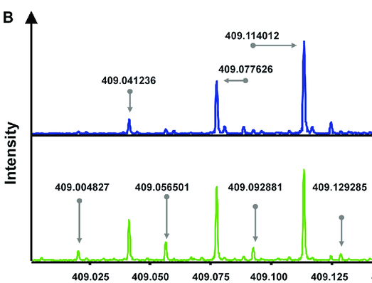
The entire workflow
Kinetics
Chemical
formula
Transition
theory
Stoichiometry
Electron donor
An e-donor half reaction
Electron balance
Catabolic reaction
Electron acceptor
An e-acceptor half reaction
Energy (delG) balance
Metabolic reaction
Carbon source
Anabolic reaction*
Electron balance
Nitrogen source
Anabolic reaction
A half reaction (e-donor or e-acceptor)

Slide 18
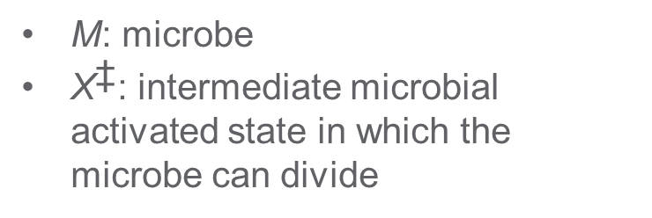
Transition theory for microbial growth
M: microbe
${\text{X}}^{\text{‡}}$: intermediate microbial activated state in which the microbe can divide
Microbes access a volume (V_{harv} or V_{h}) to harvest the chemical energy in the form of substrate molecules
Quemener and Bouchez (2014)

Slide 19
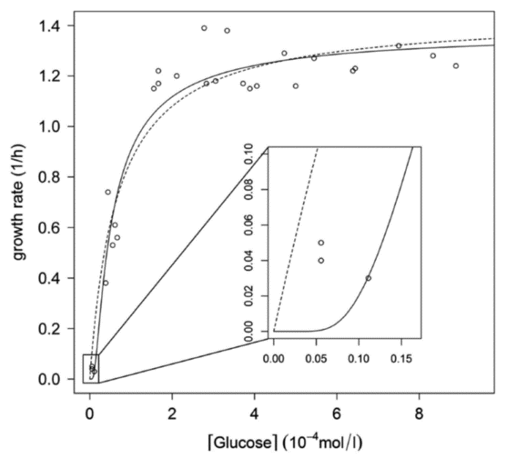
According to thermodynamics-derived kinetics, substrates of lower concentrations are not consumed
Thermodynamics-derived kinetics
M-M kinetics
Multiple substrates
Quemener and Bouchez (2014)
Compare with Michaelis-Menten kinetics

Slide 20
Other reaction rates derivable from growth rate through stochiometric relationships
All reaction rates are fully determinable from:

Slide 21
High-activity sediments (HA; south) are discriminated from low-activity sediments (LA; north) primarily in the metabolome
Phylogeny
Metagenomic functions
North
Non-vegetated
Low activity
Nitrogenous classes of compounds
Metabolomics
South
Vegetated
Hotspot
Metaproteomics
Graham et al. (Sci Total Environ, 2018)

Slide 22
Thermodynamically favorable compounds are more abundant in HA than LA
North (lower respiration rate)
Thermodynamically more favorable
Thermodynamically less favorable
South (higher respiration rate)

Slide 23
Prediction of respiration rates under diverse limited conditions
Both carbon & oxygen-limited
Oxygen in excess
Carbon-limited
OC in excess
Oxygen-limited
Weakly limited
Severely limited

Slide 24
Predicted respiration rates under “weakly” limited conditions
C-limited
O-limited
C&O-limited

Slide 25
Predicted respiration rates under “severely” limited conditions
C-limited
O-limited
C&O-limited

Slide 26
Higher abundance of thermodynamically favorable OM leads to higher rates of oxygen consumption and microbial growth

Slide 27


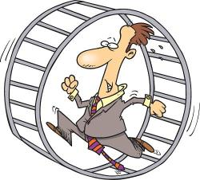
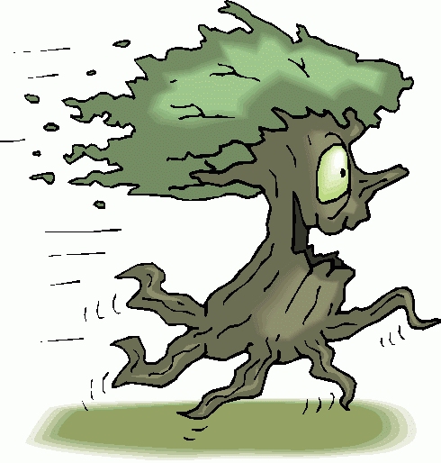
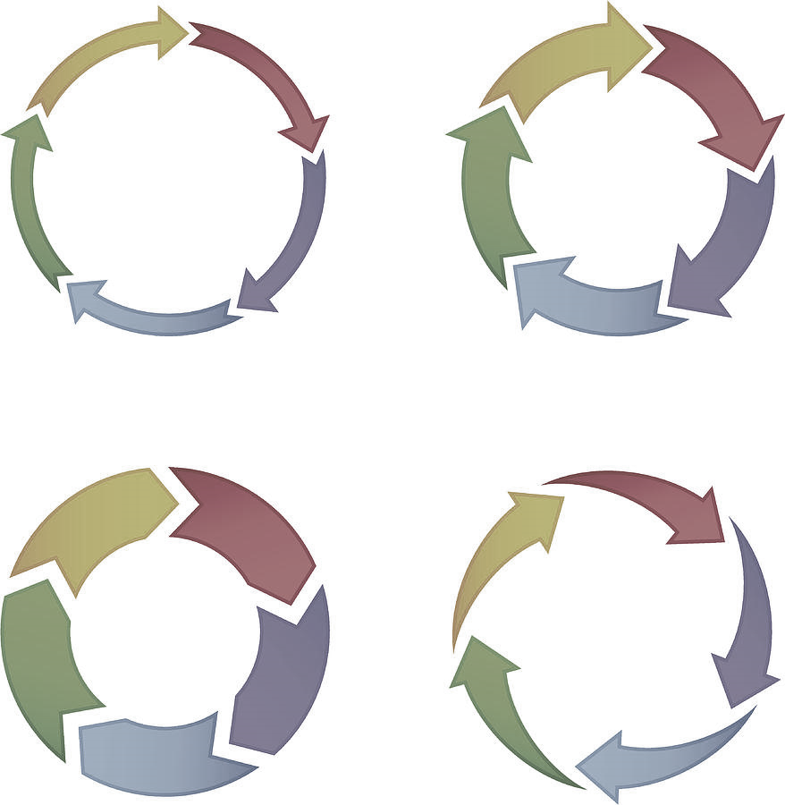



Towards omics-guided ecosystem modeling through integrative biogeochemical modeling
Substrate-
Explicit
Model
Metabolomics
Integrative
Biogeochemical
Model
Microbial-
Explicit
Model
16s rRNA
Metagenomics
MAGs
Reactive-transport models
C
N
Enzyme-
Explicit
Model
Metatranscriptomics
Metaproteomics

Slide 28
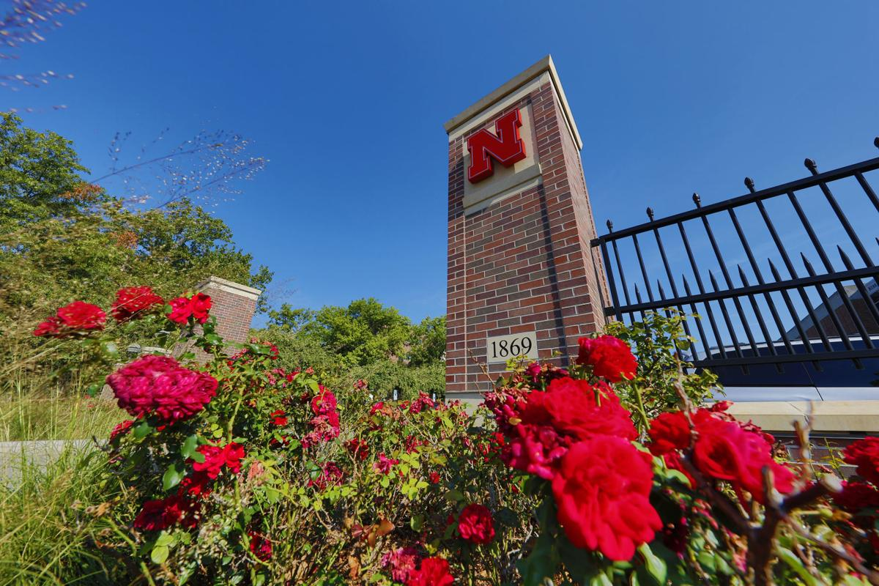
Questions before moving forward to the KBase lambda tutorial?
Hyun-Seob Song
Email: hsong5@unl.edu
https://narrative.kbase.us/narrative/65526
(public)

Slide 29

Substrate-explicit Modeling Tutorial (KBase Narrative)
Hyun-Seob Song
University of Nebraska-Lincoln

Slide 30

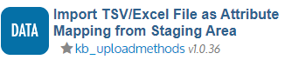
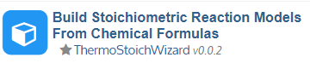
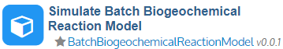
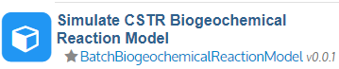
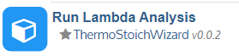
Structure of KBase substrate-explicit modeling narrative
Joon-Yong Lee
Add thermodynamic and stoichiometry files into the staging area
thermodynamic_props.csv
stoichMet_O2.csv
Add FTICR data (molecular formulas) into the staging area
Generate thermodynamic properties and stochiometric reactions
Import the data into the narrative
Examine the relationships between λ and reaction rates
Perform batch simulations
Perform CSTR simulations

Slide 31
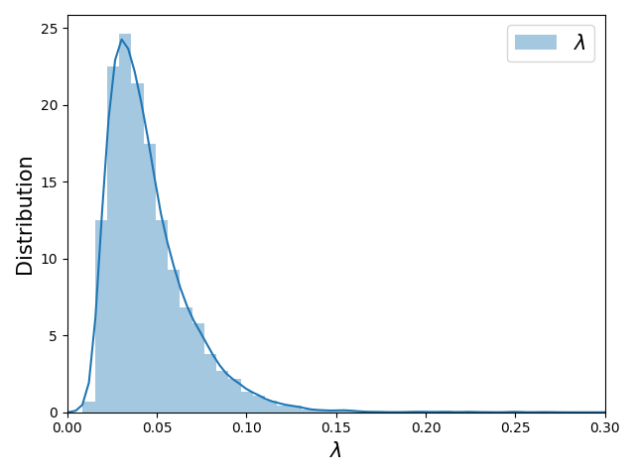
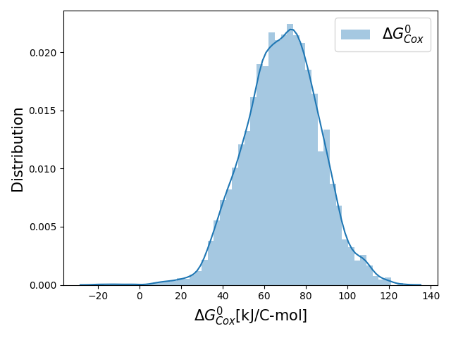
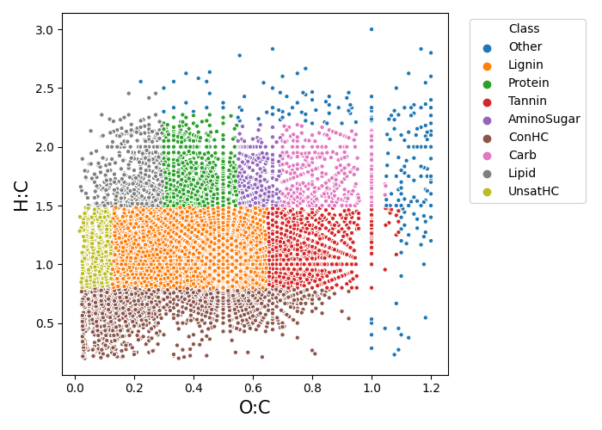
Generate thermodynamic properties and stochiometric reactions

Slide 32
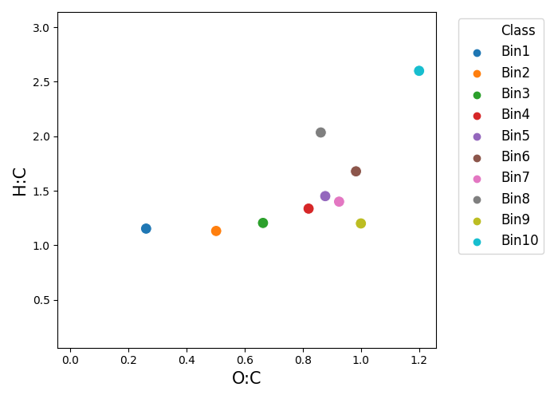
Example: division into “10” λ bins
Generate thermodynamic properties and stochiometric reactions
Bin9
λ_{ave}
λ of ave chem form
Almost equal number of metabolites in each bin
λ of average chemical formulas ≈ average λ (i.e., average chemical formulas from λ bins are reasonable representations of group thermodynamic properties)

Slide 33
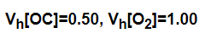
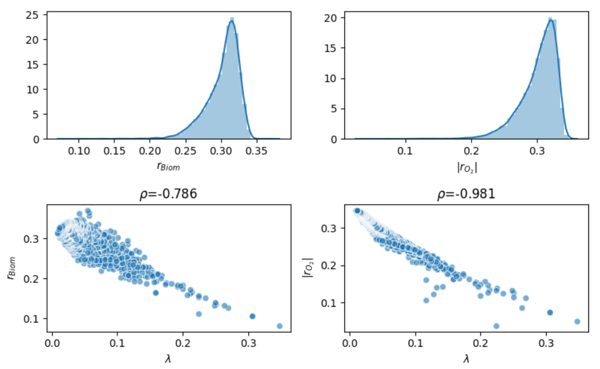
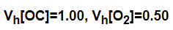
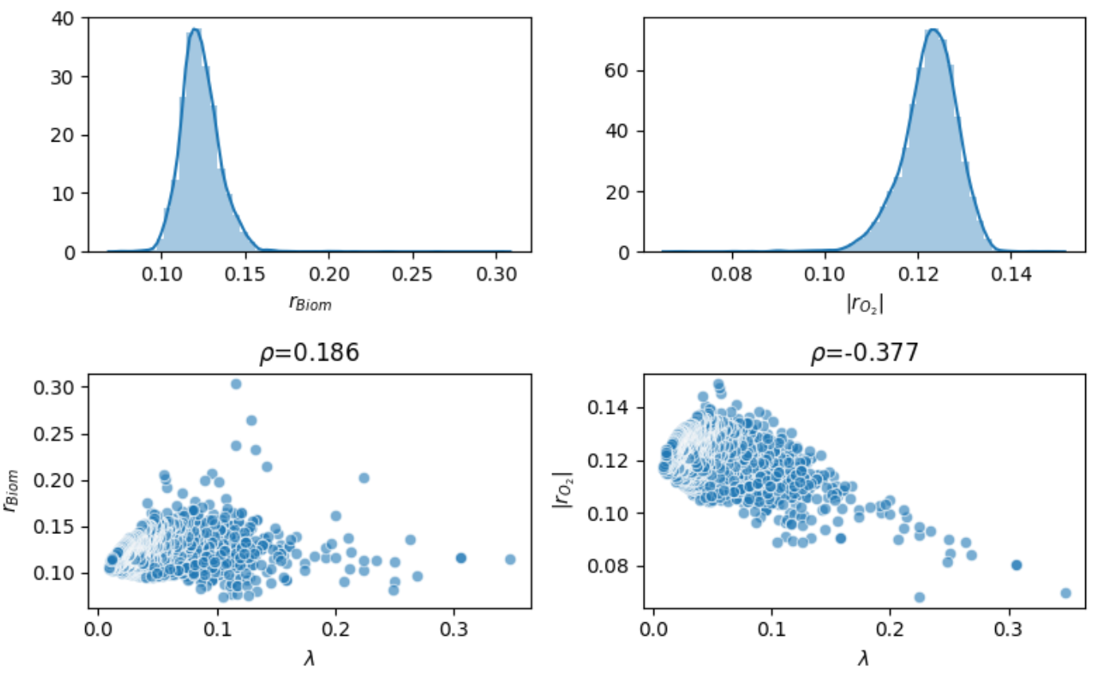
Examine the relationships between λ and reaction rates
Input parameters:

Slide 34



Examine the relationships between λ and reaction rates
Consistency with the conceptual model from Vanessa and James

Slide 35


Perform batch simulations
Lag phase
Oxygen dissolution
Kompala et al. (Biotech Bioeng,1986)
Cybernetic control variables
Song and Liu (I&EC Res, 2015)

Slide 36


Perform batch simulations

Slide 37
Perform CSTR simulations
DOC & DO (feed)
Unreacted DOC & DO (outlet)
Cybernetic control variables

Slide 38


Perform CSTR simulations

Slide 39


WHONDRS FTICR data on ESS-DIVE
 | # of samples (after filtering)
48hr Altamaha | 119
48hr Columbia | 80
48hr EastFork | 100
48hr Erpe | 147
48hr Jordan | 84
48hr Nisqually | 75
48hr WS1 | 183
… | …
Altamaha sample
Surface water and pore water
Number of peaks: 22486
Number of compounds: 11516

Slide 40
KBase tutorial narrative
https://narrative.kbase.us/narrative/65526

